Slide 1








Select A Team
Dallas Cowboys
Houston Texans
Texas Rangers
Houston Astros
Dallas Mavericks
Houston Rockets
San Antonio Spurs
PGA

Slide 2

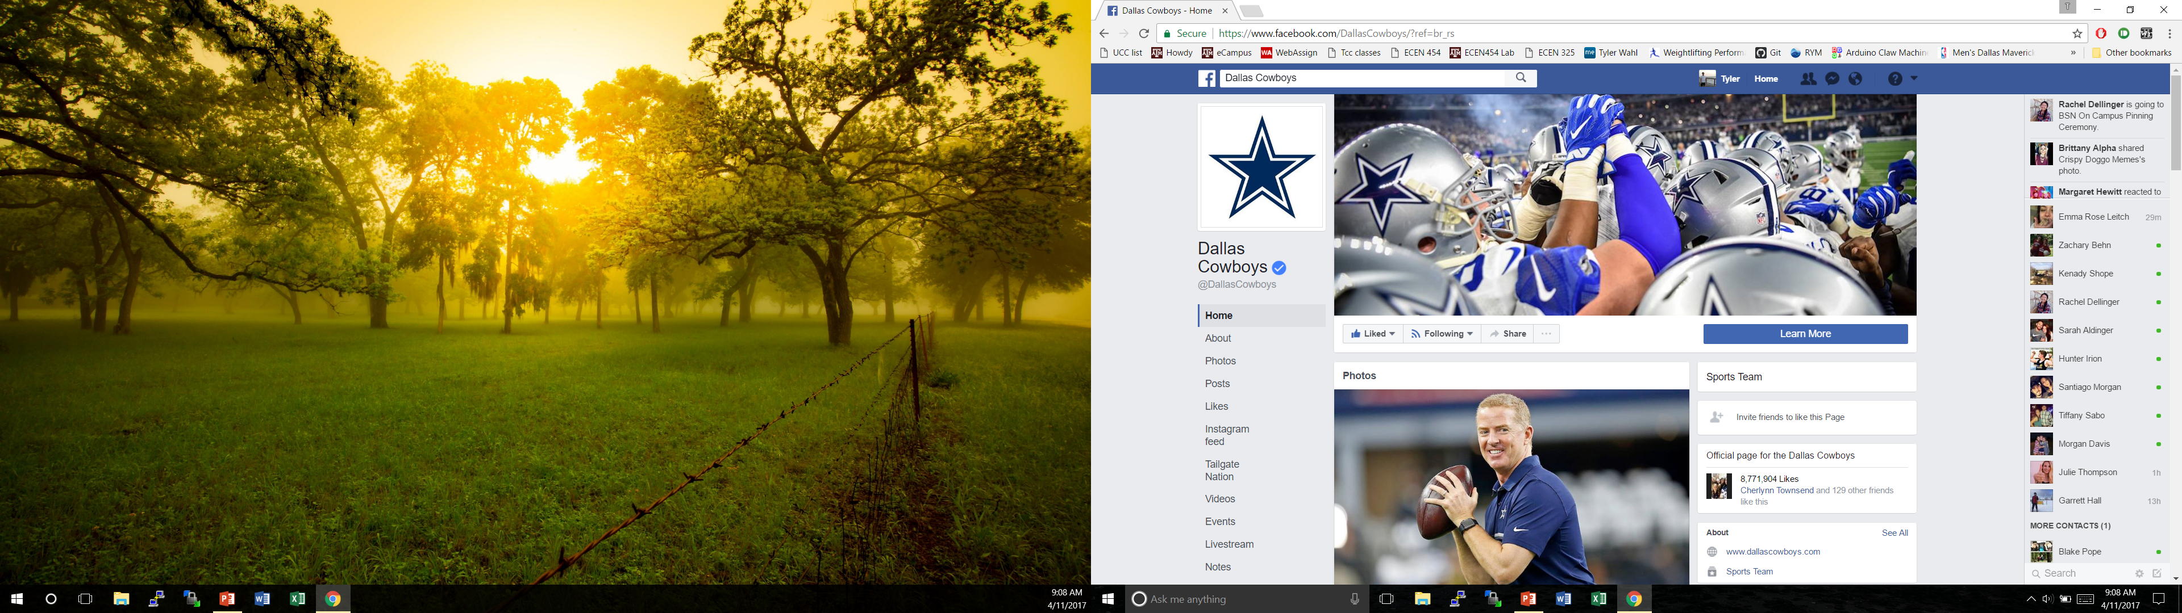
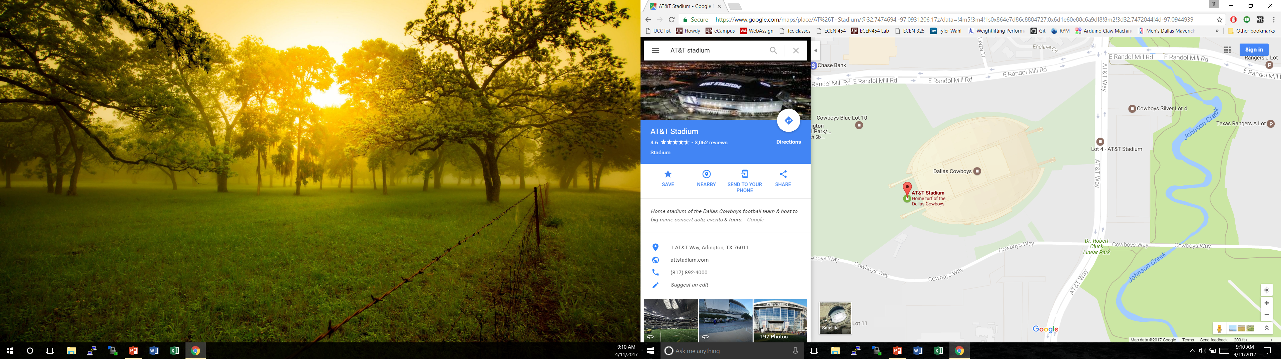
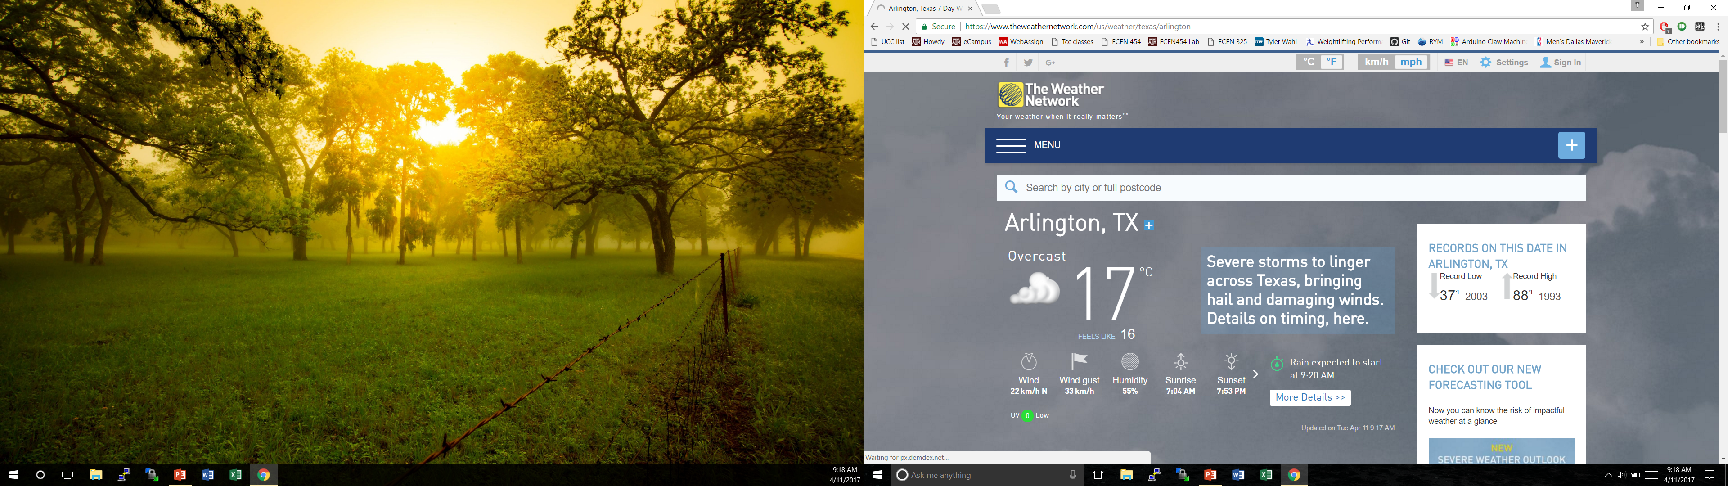
Dallas Cowboys
Roster/other Information

Slide 3
Index page will allow user’s to click on team name to take them to that team’s specific page, made by us
Clicking on team’s logo will direct user to the official NFL/MLB/NBA page for that team
Each team’s page will have background color specific to that team
Each team’s page will have info specific to them (City weather/city map/team’s social media page, etc.)
Google maps will be interactive, allowing user to zoom in/out
API’s will allow user to click on them to take them to external web page with additional info

